Slide 1
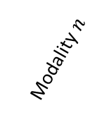
Cells
Modality 2
Position
Modality 1
Modality $n$
Velocity

